Slide 1
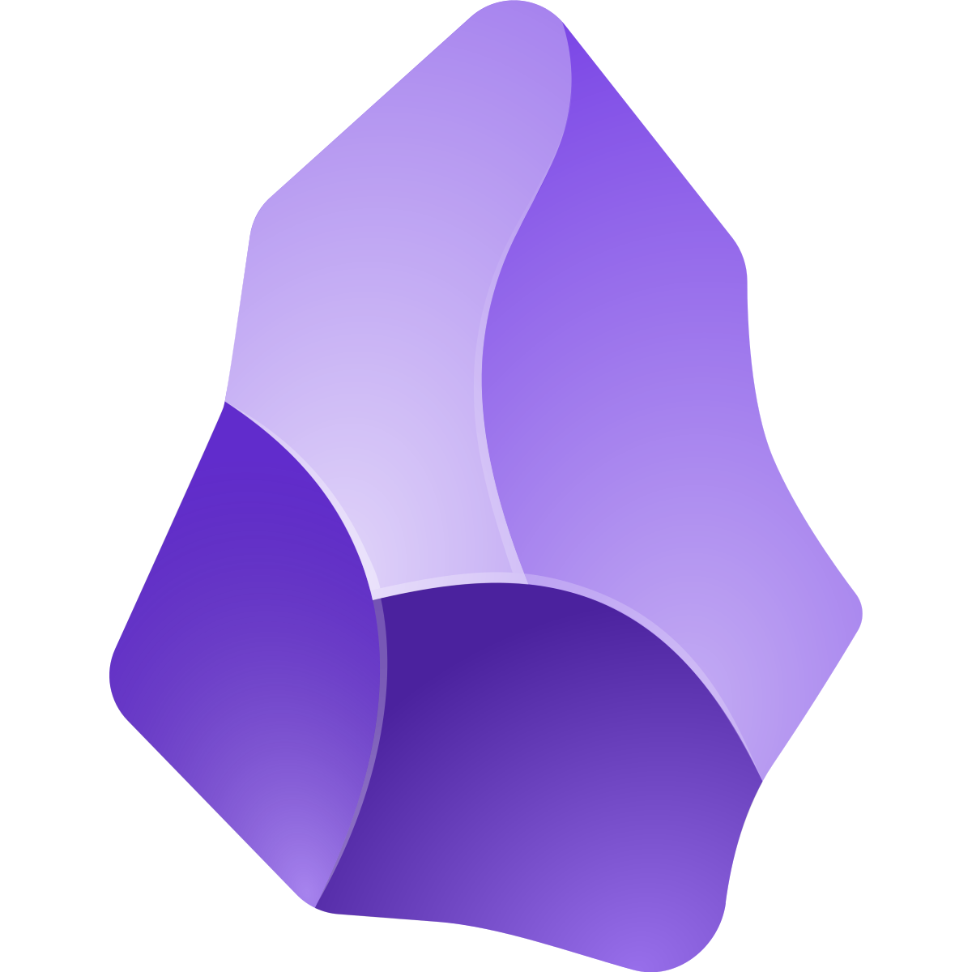
Obsidian 4 research
An integrated system for researchers

Slide 2

I want a system where I can manage tidily all the information I deal with

Slide 3

Try obsidian!

Slide 4
Obsidian is
• Markdown-based note-taking app that stores files locally on your device
• Links notes together (create a link simply by [[note_name]] or with autofill)
• Highly customizable with plugins, themes, and community extensions

Slide 5
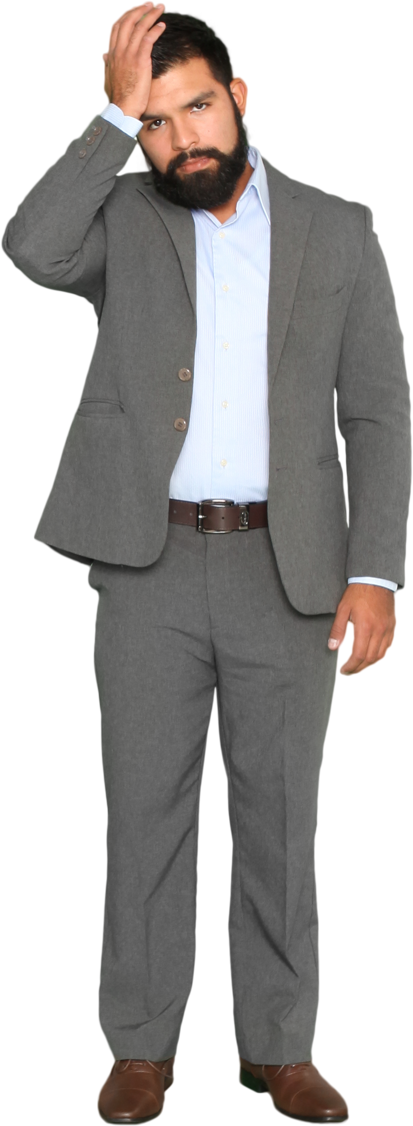
I’ve started by myself but I have a headache! There are two many options!

Slide 6
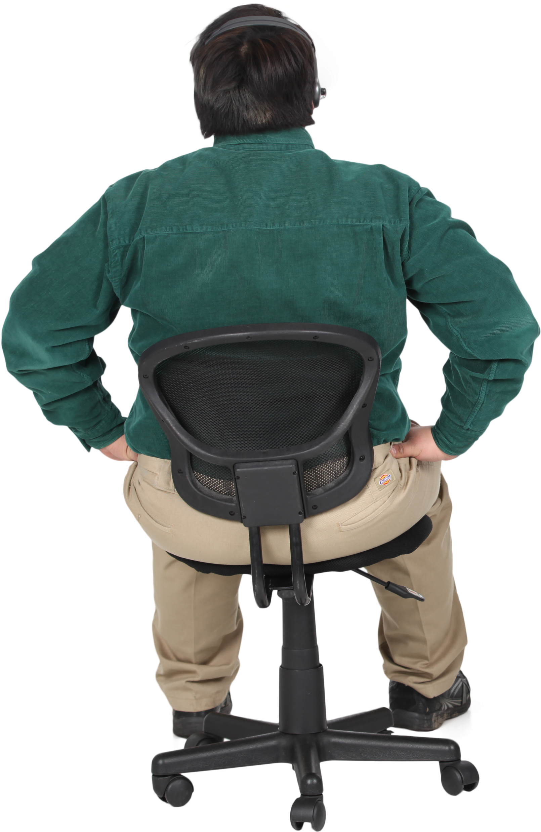

Slide 7
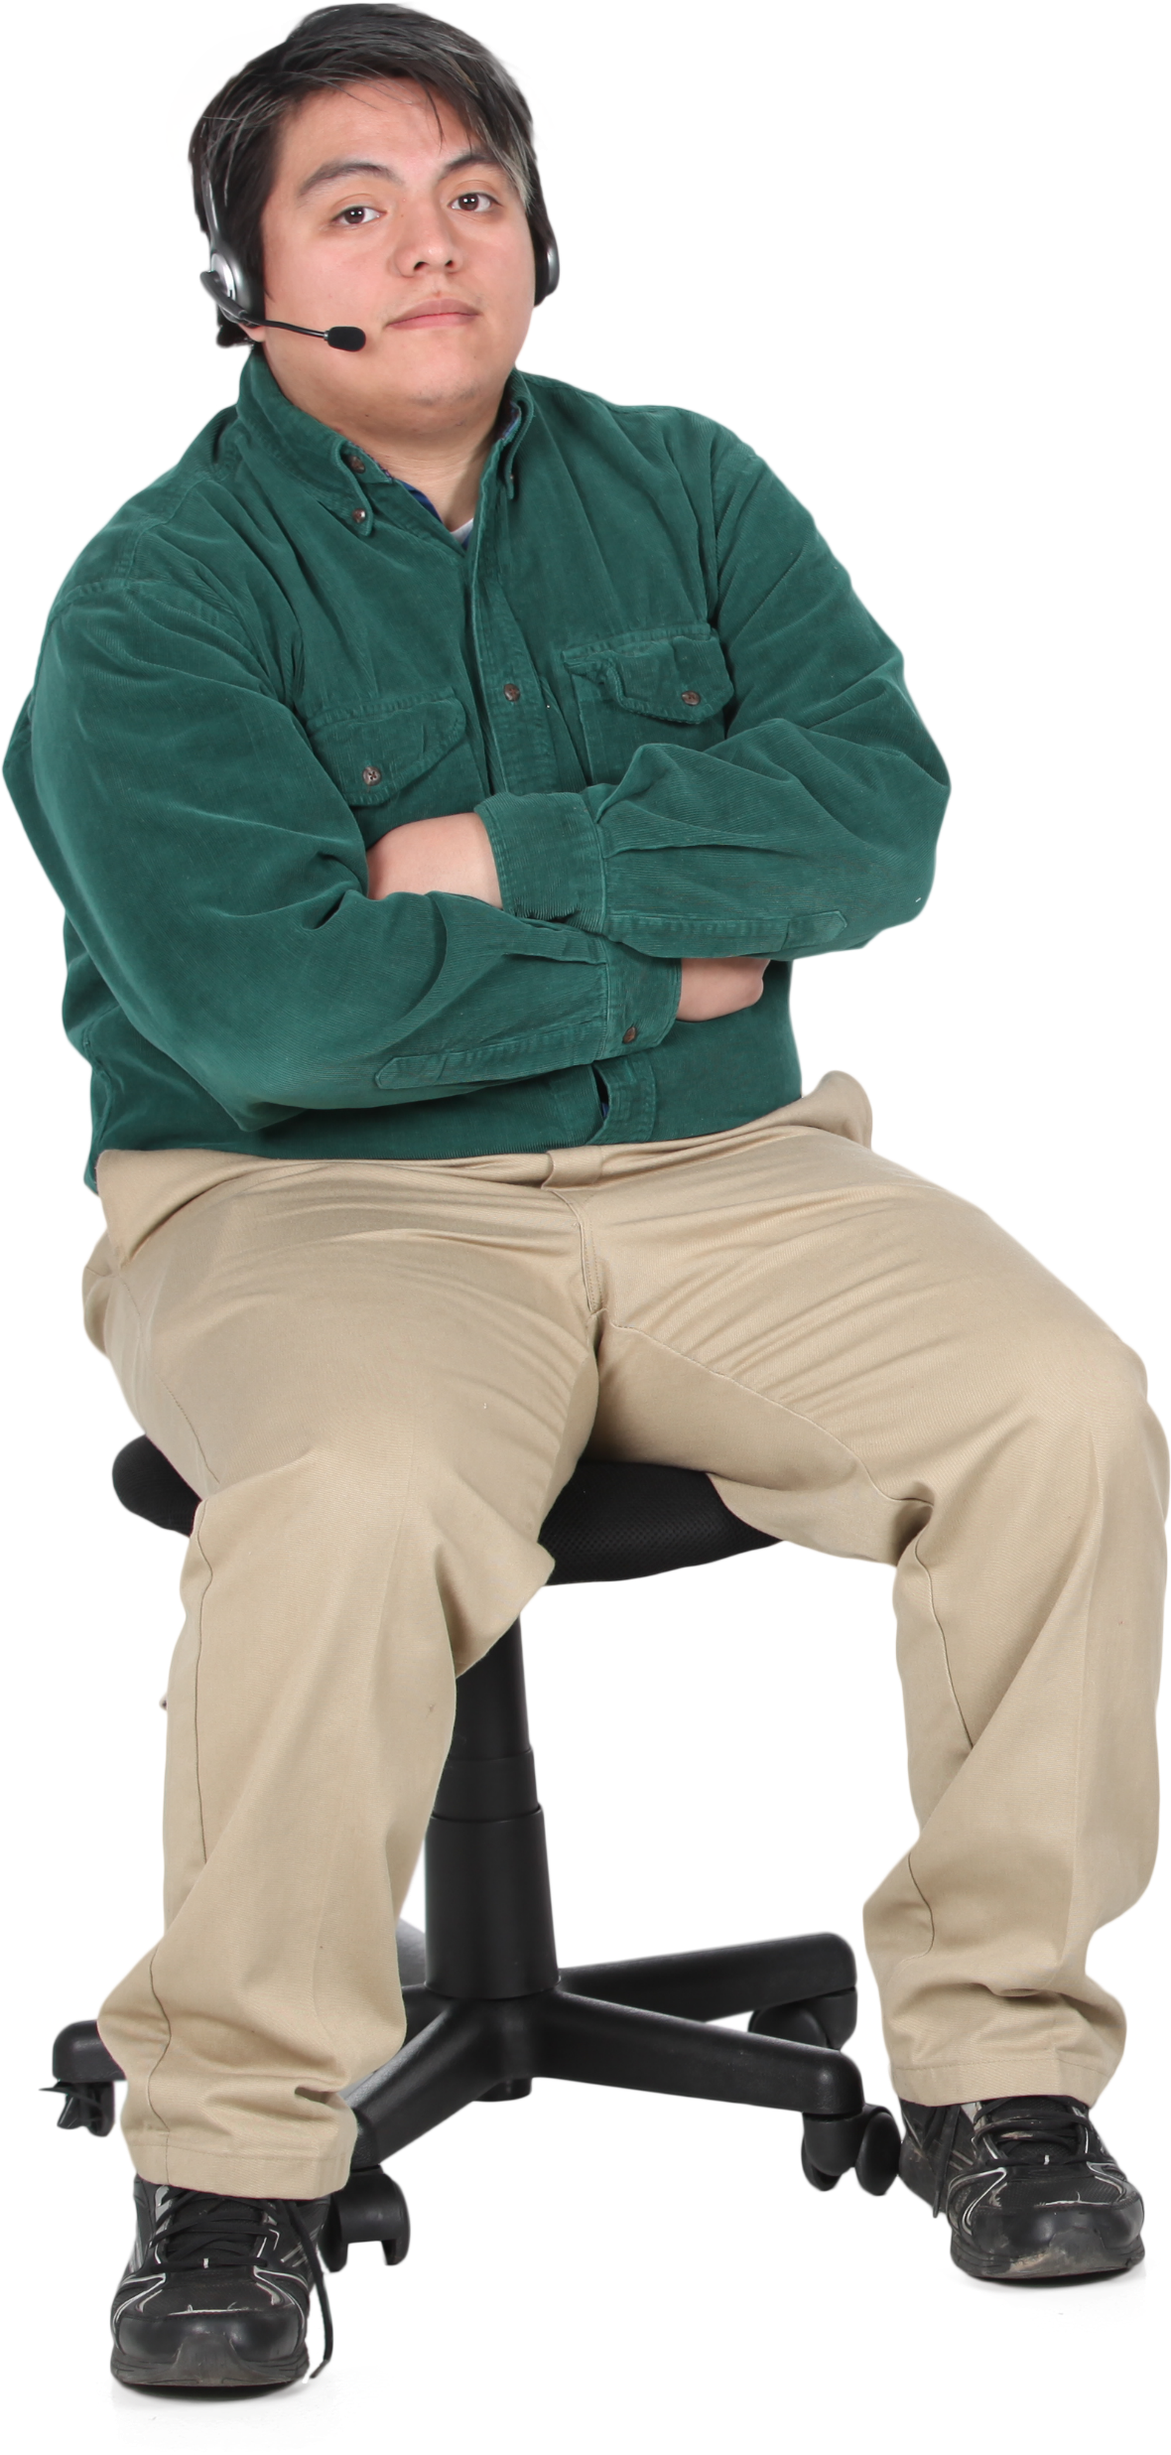
Sorry I was looking outside the Windows.
With my friend Matteo, we’ve created a system that you can easily download and start using, which we find very useful for researchers!

Slide 8
The idea of the system is:
We have few high-level thoughts
- «I’m working on project A, B, and C»
Some middle-level thoughts
- «For project A, I should read these 3 papers»
Many (too many) granular thoughts
- «For project A and paper Calcaterra et al. 2024, I have to note that it’s the best paper I’ve ever read»

Slide 9
With Obsidian we can link all the levels, to make it
Easy to shift from one level to another and
Never lose track of the countless granular information that we deal with
Across:
Things to do
Papers read
Notes on incremental research progress etc.
And we can also do ex-post monitoring on what we did

Slide 10
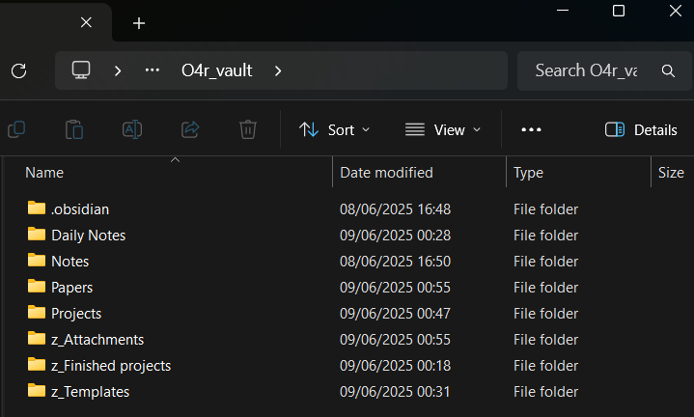
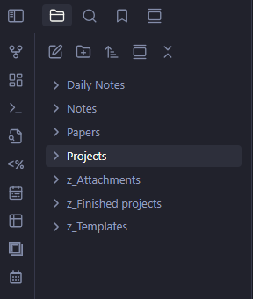
Let’s get down to business! This is where it gets boring
Obsidian is based on a folder in your laptop, which is called a vault
In Windows Explorer
Within Obsidian

Slide 11
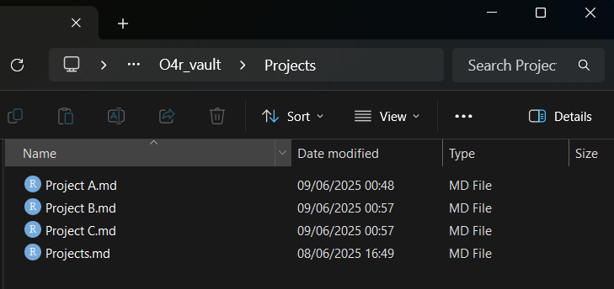
This is very convenient, as every note is a .md file that can be read by any text editor
No matter what, with any laptop you can open and read these files (what people call being futureproof )
Also, you can act on your files also outside Obsidian (e.g. bulk delete from Windows Explorer or – pro tip already – bulk find-replace with VSCode)

Slide 12

To understand the rationale behind this system, let’s move from the bottom up

Slide 13
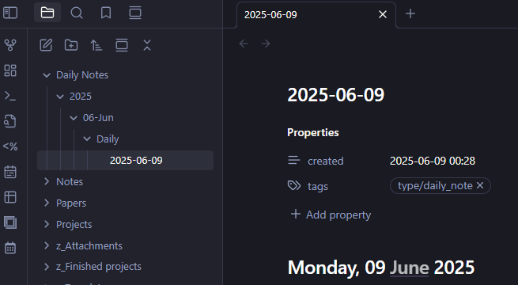
Daily notes
Daily notes are the backbone of your work
They are stored in the Daily Notes folder within year, month, type subfolders (thanks to the plugin Periodic Notes, you could also have Monthly or Weekly notes)
The name is simple and machine readable

Slide 14
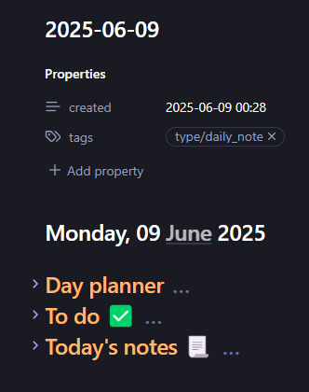
Each daily note has some properties (as any Obsidian note)
The title of the note is a more human version of the day
It’s divided into 3 subsections:
Day planner
To do
Today’s notes

Slide 15
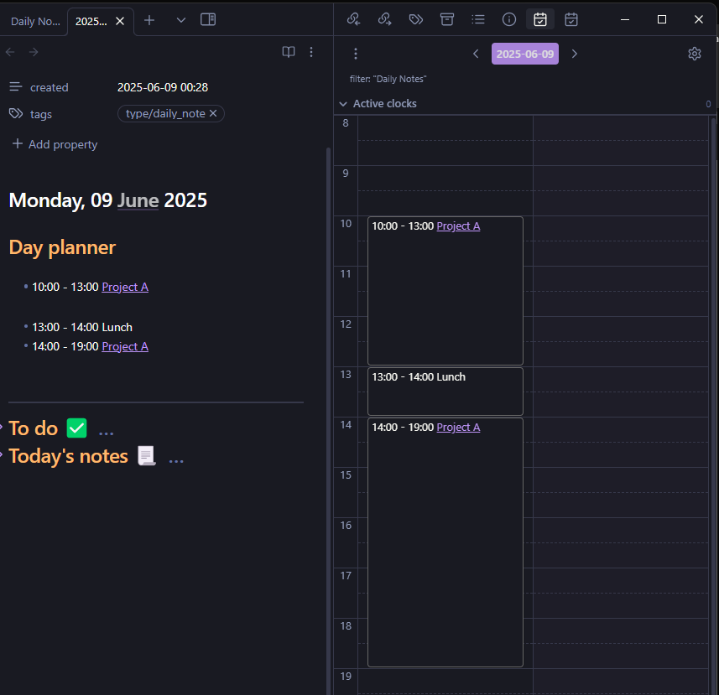
Day Planner
Very cool plugin. It allows us to plan our day using time slots
The section is populated with defaults that can be adapted and that are specific to each day of the week
The plugin gives this viz of the day by opening the toolbar on the right
You can also “add a remote calendar” to view also your meetings etc.

Slide 16
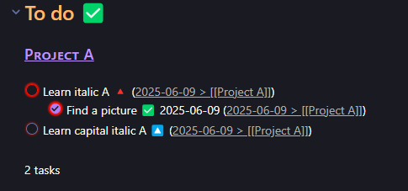
To Do
Leverages on the powerful Tasks plugin
It selects all active to-do items and lists them by project (i.e. by the heading under which they have been written)
A custom theme colors them by different priority levels, some other customizable options declutter the view

Slide 17
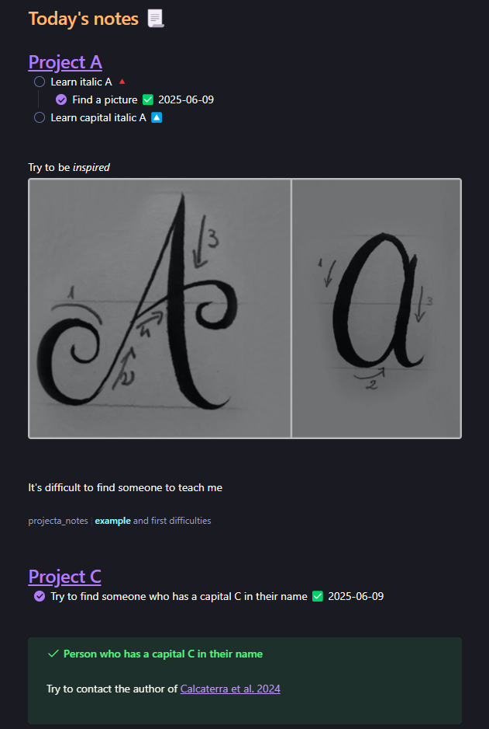
Today’s notes
Where the information is!
Use ### to create headings and link a project, and for each on which you work during the day
- Add to-do items - Write stuff (various formattings) - Paste images (linked actually) - Link other pages - Write summary properties (remember this)

Slide 18

🎶Started from the bottom now we here! 🎶 That is the middle level

Slide 19
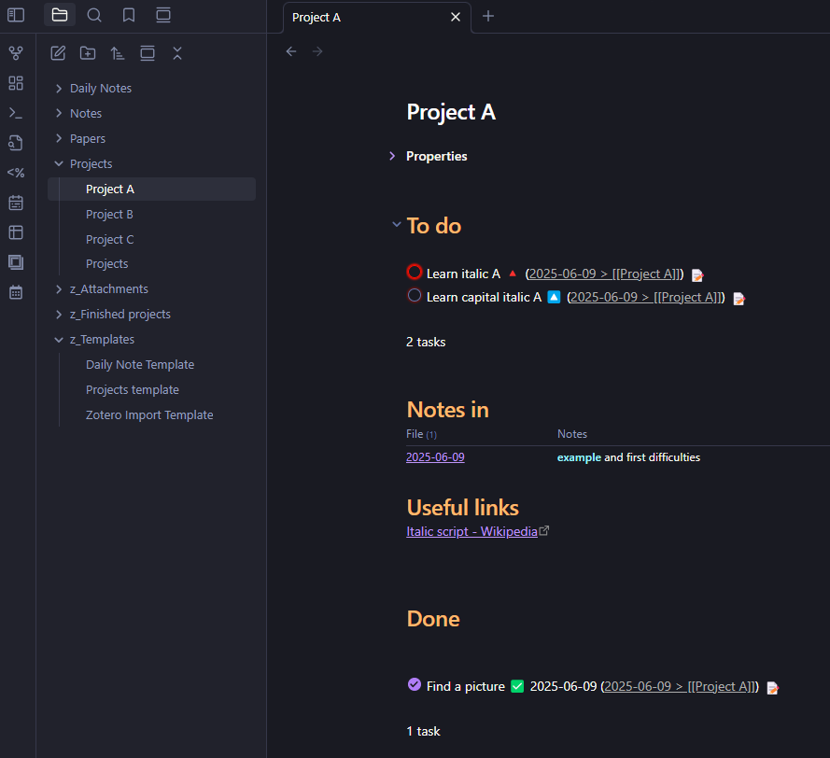
We work with projects
Each project note is useful to move to specific notes where you stored info that you need!
- A bunch of properties
- A summary of the specific to-dos
- A list of all the daily notes where you have important information (i.e. the summary properties in the Daily Notes)
- Other useful information and links
- A list of done tasks

Slide 20

And now the MASTERMIND level
Where we get a bird’s eye view on everything like Sauron or whatever I’m not a nerd

Slide 21
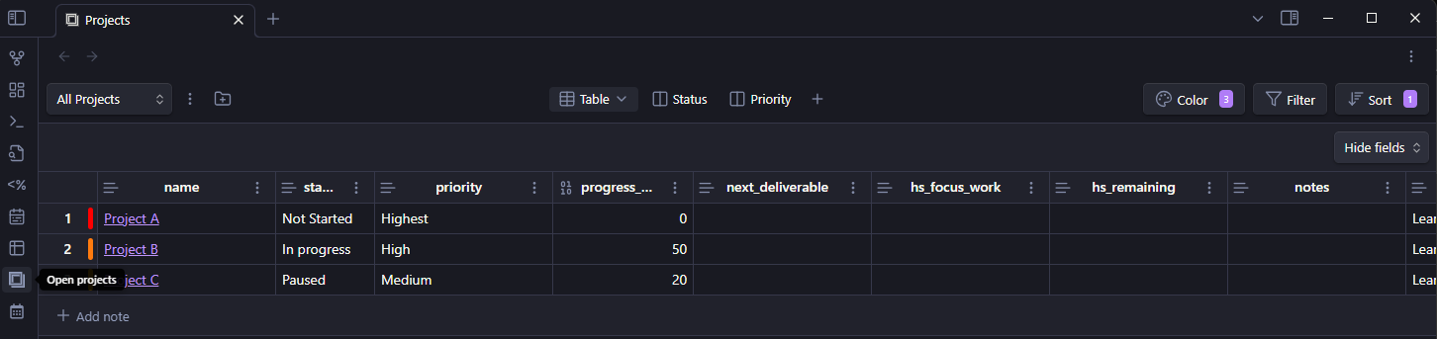
Thanks to the Projects plugin, we can visualize all projects and their properties in a summarized way
This is useful to keep under control what we’re doing, quickly switch between one and the other, or edit properties of multiple projects easily in the same moment

Slide 22
Ok now we saw basically the basic ingredients:
Daily Notes contain all our thoughts and to-dos
Project notes link the important notes where we know we wrote important stuff, which can be found easily!
The Projects plugin view allows to abstract even more

Slide 23
Now the cooler more custom stuff for researchers
Until now, it was just a description of an organized note-taking system. But the vault is preset to do more powerful stuff:
Seamless integration with Zotero to really keep all the information on the papers we read accessible
Do time-tracking to monitor our work and analyze it ex-post
The big advantage is that you can keep everything in one place and seamlessly time-track your work while you follow your to do list while you note stuff on that task, etc.

Slide 24
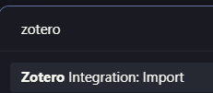
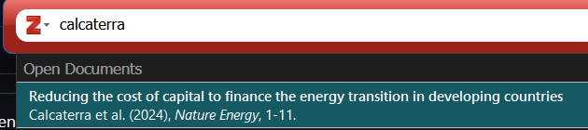
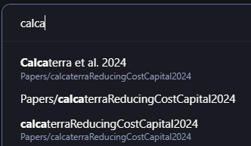
Zotero integration
- While Zotero with Better BibTeX extension is open, press Ctrl+P, which is the standard way in Obsidian to access generic commands, and access Import by Zotero
- Select the desired paper (like in Word)
- Press Ctrl+O which is the standard way in Obsidian to open notes: a new note with the paper has been created! Open it

Slide 25
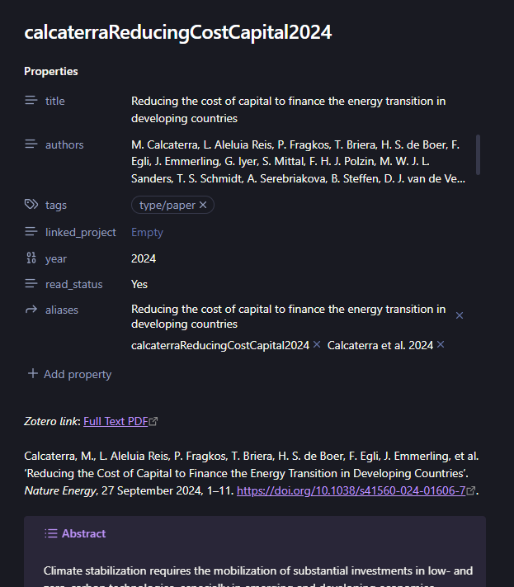
The paper has been impored with:
- A custom name to avoid ambiguities
- Some metadata, among which different aliases: it means that, even if the name is that ugly univocal thing, I can link the paper simply with the title or with [[Calcaterra et al. 2024]]
- A Zotero link to the full paper, to open it quickly
- A citation key to copy paste quickly when needed
- The full abstract of the paper

Slide 26
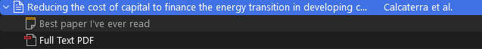
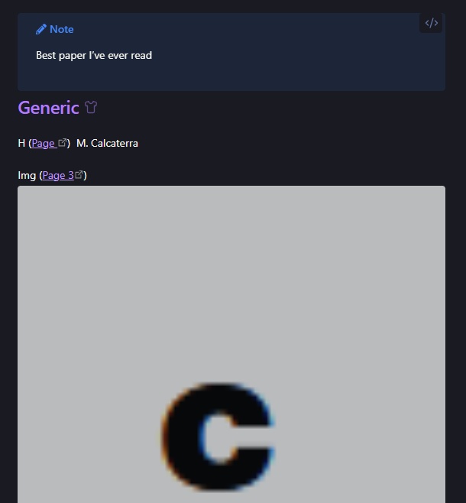
- Notably, also the «Notes» from Zotero will be imported
- But also all the highlights, divided by color, and the images that have been highlighted with Zotero’s “Select Area” tool
→ You can access super quickly to the really important information from any paper, for example to just refresh your memory

Slide 27
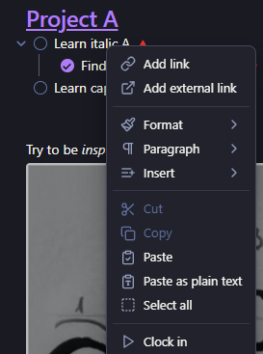
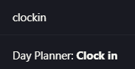
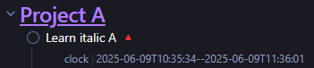
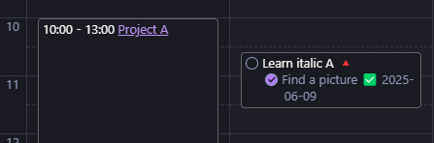
Time-tracking
This leverages on theDay Planner plugin:
- Right click on any task and select clock-in / or put your cursor on any task and Ctrl+P clock in
- When you’re done, do the same for clock out
- The plugin will create a time-stamp on that task, and will visualize it in the bar on the right
- Clearly, any task can have multiple instances etc.
- The time and date can be edited manually by editing the text

Slide 28
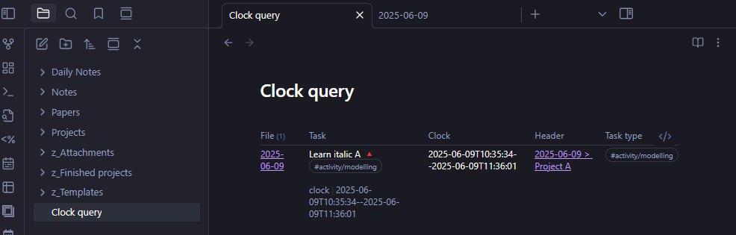
We can use this to monitor our work in any specific day, but also to monitor our work in a longer period of time:
→ Opening the clock query will filter all the tasks, isolating the clock property, the header = the project, and the task type which is any tag that categorizes it (written in the task line)

Slide 29
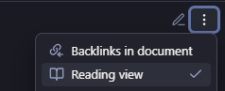
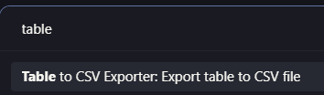
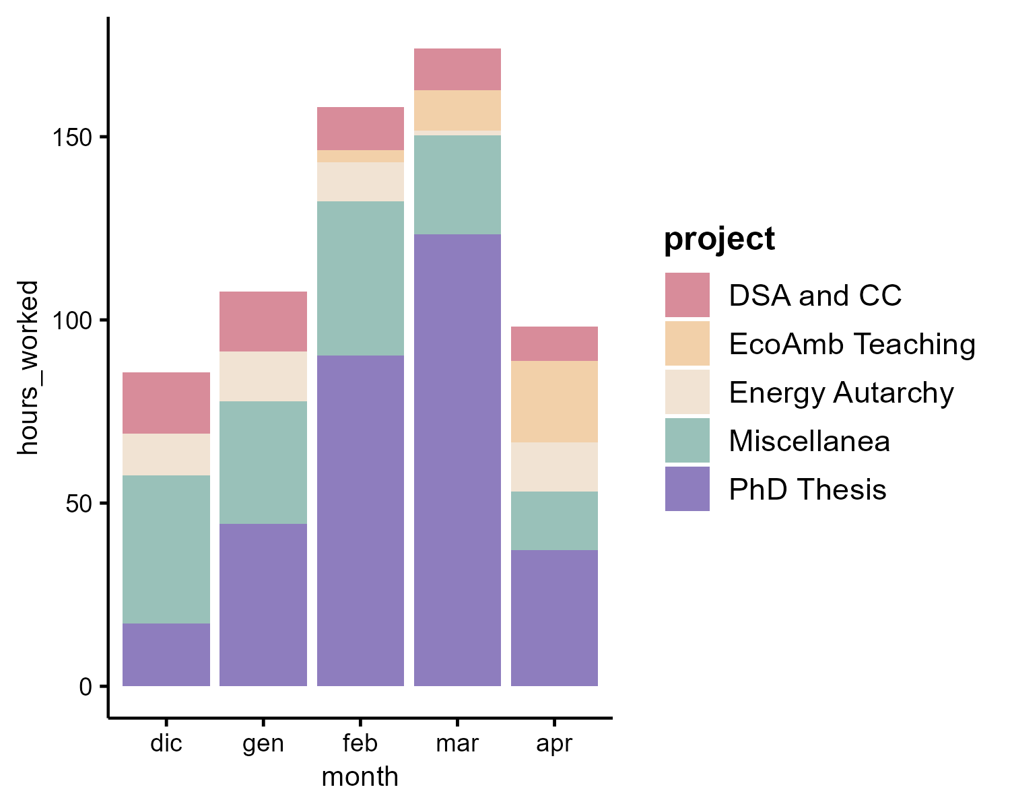
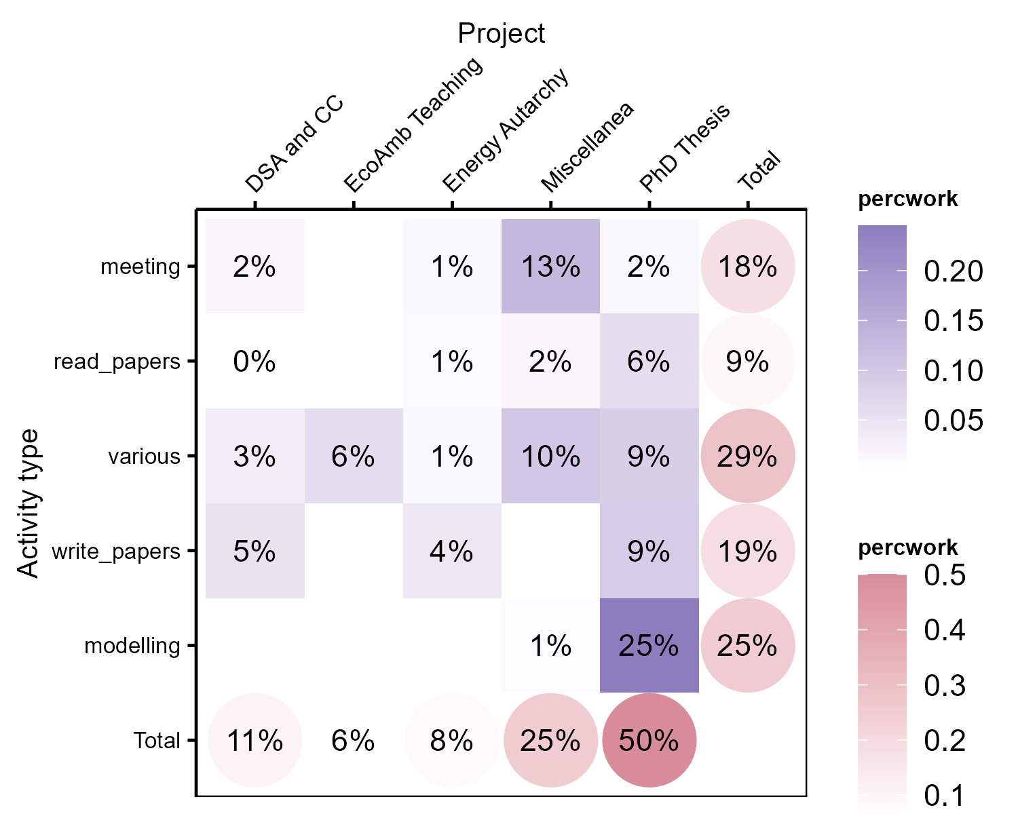
We can extract all this juicy data and analyze it however we like!
- Put the note in Reading view with the three dots on top right
- Ctrl+P and select Table to CSV Exporter: Export table to CSV file: this will create a file table-export-NNN.csv, where NNN is a counter
- Open now in R the project and the .qmd in the folder O4r_timetrackingdataviz, making sure the input file has the right name. This allows to import the data, process and clean them, and create some stylized charts

Slide 30

Yeah ok I’ll say «cool» to please you, but how can I access this?

Slide 31

Ah yeah sorry I forgot to tell you!
Clone the repo GitHub - MatteoCalca/Obsidian4research
Install Obsidian and select “Open folder as vault”, find the cloned folder and open the folder O4r_vault
Trust the author of this vault (not me, the creators of the plugins)
You’re good to go! (hopefully idk)

Slide 32

How does this work tho??
How can I edit it for my specific needs?

Slide 33
Let’s see it better

Slide 34
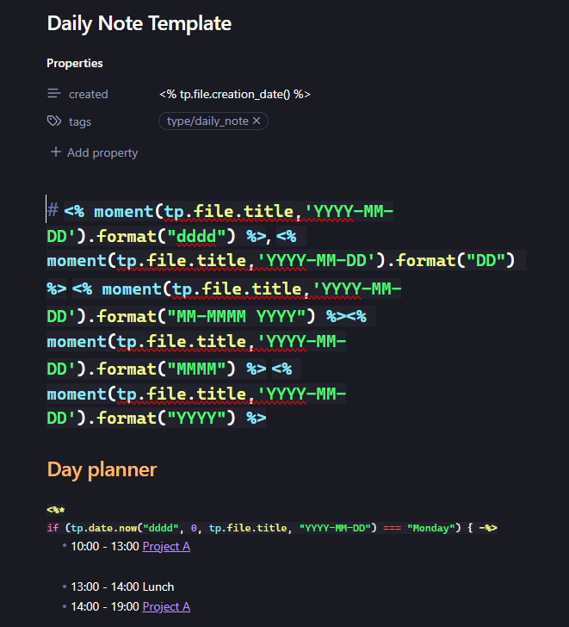
Everytime you create a new note in a specific folder, the Templater plugin runs some code and substitutes <%uglycode!1!%> with some nice custom stuff
E.g. the daily note template will create a nice human readable title, and in the Day planner section will have a different “default planning” for each day of the week. You can edit it to match your planning

Slide 35
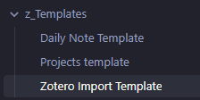
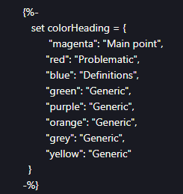
You can find the 3 default templates in the folder z_Templates
The Zotero import template is even uglier, nobody knows how it works but it does. What you can customize is the name of the section corresponding to each highlight color (I should probably quote the place online where I found it, but I don’t know it anymore)

Slide 36
The other important things: Queries
The powerful thing about Obsidian is that you can run queries to extract information from the messy blob of Daily Notes and common notes.
Queries are of two types based on the plugin:
Tasks queries are for to-dos. They will filter across tasks
Dataview queries are for other information. They are based mostly on properties, which are of different types: some are at the top of the file, some are inline properties, feature of Dataview, and are written as [property_name:: whatever you want the property content]. This is what clock timetracking is, but this is also what you should write as summary to link a Daily Note to the Project note

Slide 37
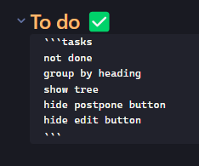
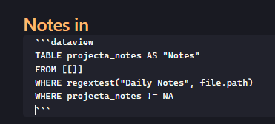
The tasks queries are very human readable and you can very easily edit them to suit your needs
The dataview queries, like the clock query or the «Notes in» query in the project are a bit more obscure but in the age of AI this is not a problem
You can build on this to make your own filters and retrieve the information you prefer

Slide 38
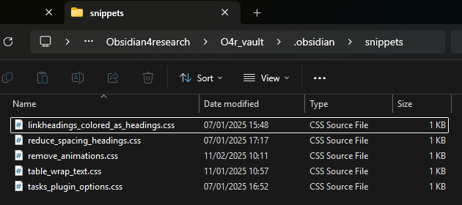
STYLING
Having a soothing graphical view is fundamental.
Custom stuff can be done by adding .css snippets in the dedicated folder under .obsidian in your vault. What you might want to change is linkheadings_colored_as_headings.css (that colors headings like headings and not like links) and tasks_plugin_options.css (that manages some tasks colors like the hue for different priorities)

Slide 39
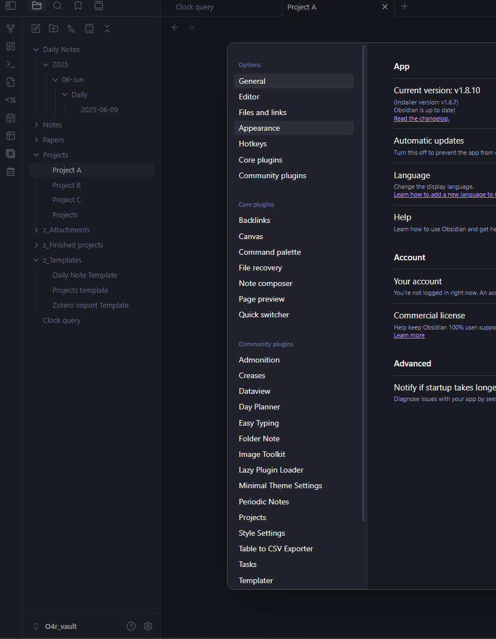
There is also two easy ways to manage styling:
Click on the little gear at the bottom to open settings
- Minimal Theme Settings gives you some high-level themes you can apply, as well as generic options
- Style Settings gives you more control on everything more granular, like color of the background, color of accents, color and font of different heading levels, etc. (it’s a lot of settings)

Slide 40
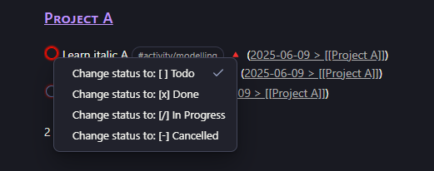
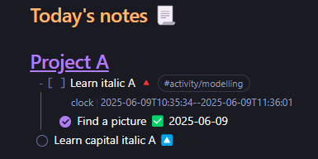
Other cute stuff
Minimal theme supports many tasks statuses. The ones that are there already are some simple ones, right click in the Tasks query on the checkbox or write it directly inside the [ ] in the original task

Slide 41
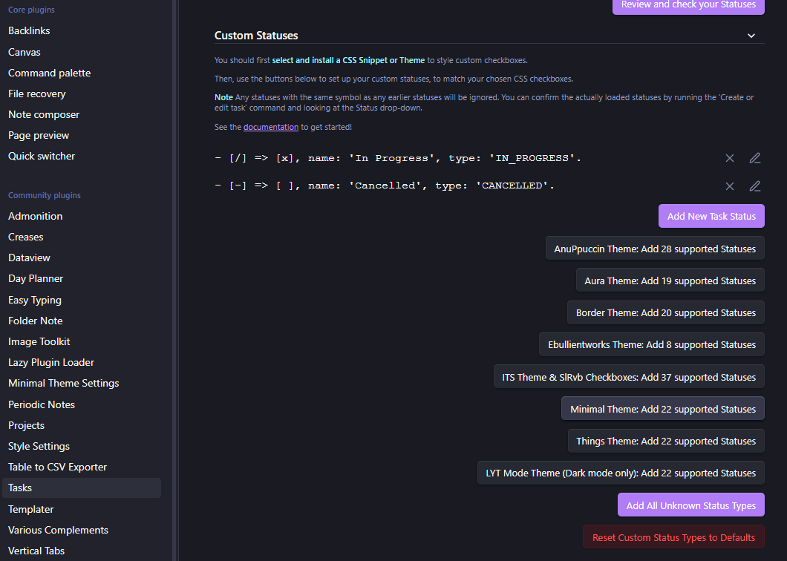
You can add other custom ones from the options of the Tasks plugin
The Minimal Theme that is already installed already can give you 22 more, which you can add by clicking the related button
Others refer to other themes (which you can always install)

Slide 42
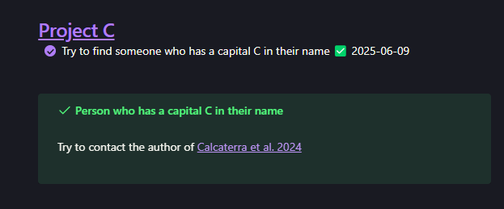
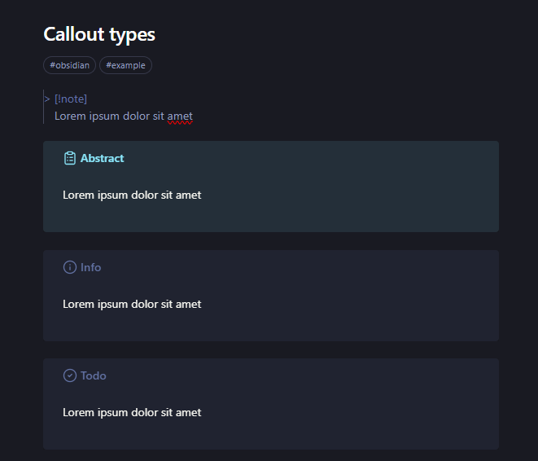
Callouts
Callouts are cute ways to highlight your text, see e.g. the example note
To insert one, simply Ctrl+P and find insert callout
Callout types can be found online but I also added them to Notes/Callout types (Ctrl+O callout types to open it and find the most suitable one)

Slide 43

Now, a final bit on how we use it for time management
(I’m tired as well)

Slide 44
- The metric I use to monitor my work is the focused hour by project and activity type
- Whenever I start working on something, I make sure I have a task written that tracks it (I find it also good to say to myself: “Now I’m trying to accomplish this”, and has to be something doable in a reasonable amount of time not “writing a paper from scratch to publishable”)
- I clock in when I really start working on it, and I clock out when I take a break. This really keeps track of how much I’ve worked. Editing the timestamp is very useful in case I forget (often) and in case I do many small breaks (e.g. I chit chat approx. for 5 minutes during this work slot, so I might reduce the slot by 5 minutes once I clock out)

Slide 45
Each task can be tagged with the activity type. The ones I use are:
#activity/read_paper
#activity/meeting
#activity/write_paper (used also when I do graphs or look at data)
#activity/modelling
The task can also have no hashtag and be simply a generic task
The clock query will extract them, and the R script will bin the hours worked also by type
I have a dummy project where everything that is not project specific falls into (like this presentation)
The idea is to categorize everything you do, so you can see actually how much you do in how much time

Slide 46
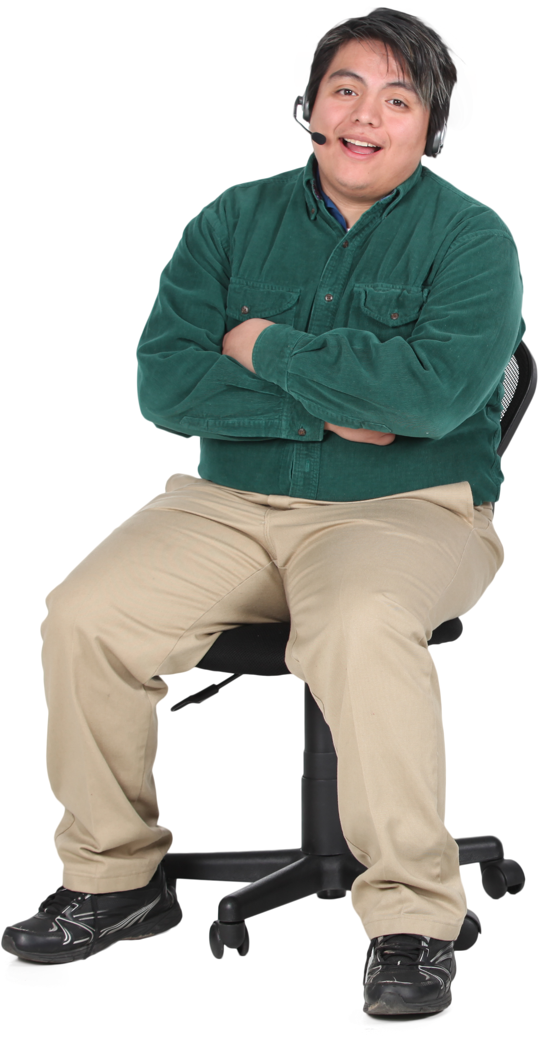
I hope this presentation was interesting, you can take inspiration from here and build the system that works the best for you
Hopefully I made it a bit easier to start!
Questions?

